Slide 1
IOGP Start Work Check (SWC) Overview

Slide 2
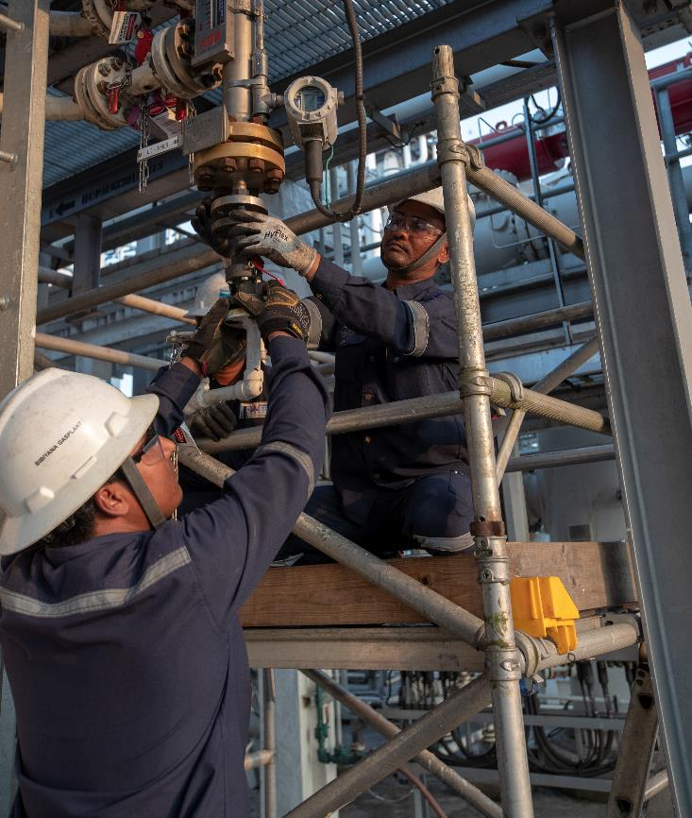
Why are we moving to IOGP Start Work Checks (SWC)?
Adopting an industry standard
Our current SWCs require the use of 2 separate documents to be effective: Start Work Check and Save Your Life Actions (SYLA)
Our Business Partners work with our peers as well – which in the past meant different processes and tools including SWCs.
One Simple Document
SYLA “How-to’s” included in the IOPG start work checks and fit on one page
Industry Standard Tool
Promotes consistent use for similar work across industry
80% Contracted Workforce
Alignment on lifesaving actions is critical in preventing fatal outcomes
2
Notes:
Why move to adopting an industry standard tool?
Current State:
Our current SWCs requires the use of 2 documents to be effective:
The Start Work Check which is a list of Save Your Life Actions that must be put into place and verified.
The Save Your Life Actions (SYLA) document which expands upon the actions to give the workforce some “how-to”.
Our Business Partners work with our peers as well – which in the past meant different processes and tools including SWCs.
Future State:
The IOGP SWC has “how-to’s” built into the center column of the document which consolidates the tool into one easy to use document.
Adoption of the IOPG SWCs industry wide will provide clarity and alignment – leading to consistent use of the SWCs by contractors and operators doing similar work across the industry.​
For an industry with an ~80% contracted workforce, alignment on lifesaving actions is critical in preventing fatal outcomes.

Slide 3
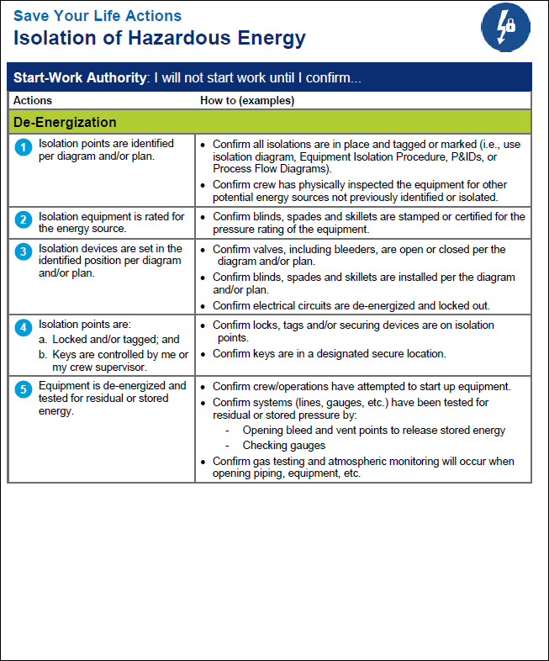
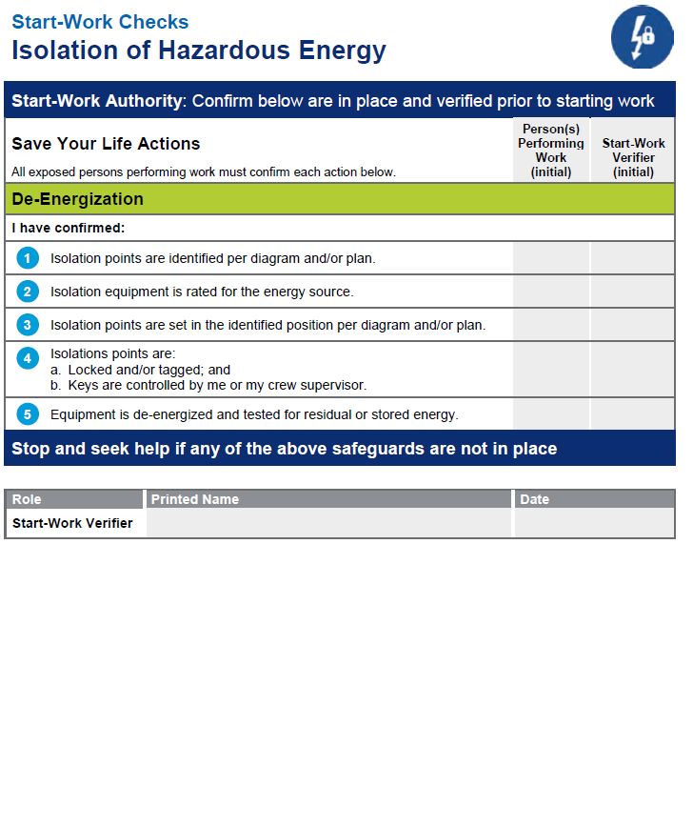
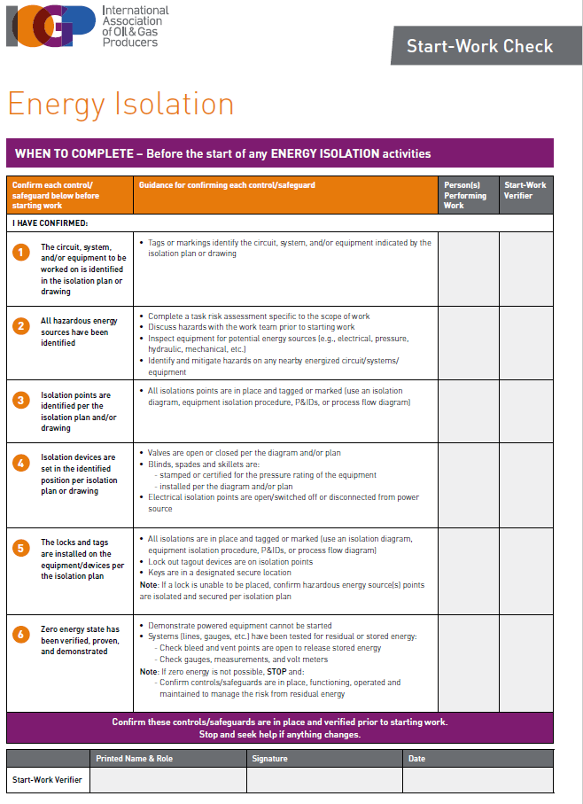
Start Work Checks – What’s Changing?
Notes:
Transitioning from WJO Save Your Life Actions / Start Work Checks to the International Association of Oil and Gas Producers (IOGP) Start Work Checks
Explain that we’re transitioning from SWC to the IOGP SWC. The reason for the change is that IOGP has developed these common rules and checks to help workers in the oil and gas industry use a common system no matter which country, rig, or company they go to work for. IOGP members are working towards full implementation by 2025.
Mention that for man-riding activities, there is a specific SWC form. We were previously using the work at heights form. This manriding SWC will help focus safeguard verification on the unique equipment in use during manriding.

Slide 4
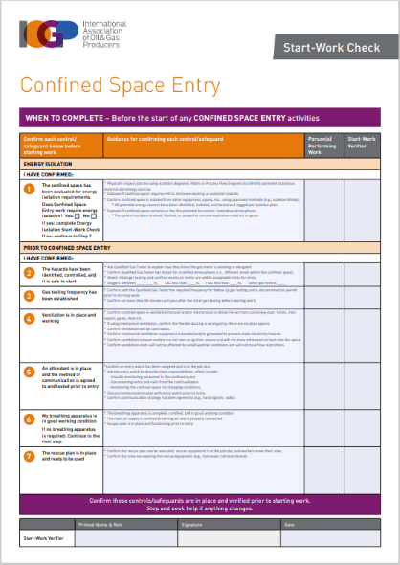
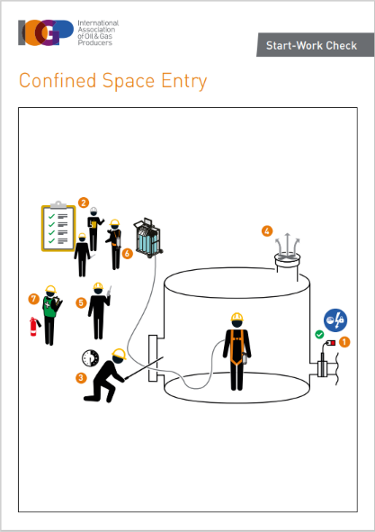
Example of an IOGP Start Work Check
This column provides guidance and examples on how to complete the check
Dual assurance verification
Full page diagrams to aid understanding
Each row is a check item
Final row completed once all check
items verified
Notes:
According to the workforce, the SYLA document was not being utilized to its full potential. This is why IOGP went to a single document format.
The Checks have three human performance aspects as part of their design:
Place keeping (by marking each step as complete)
Peer review (the Verifier role)
Stop and seek help

Slide 5
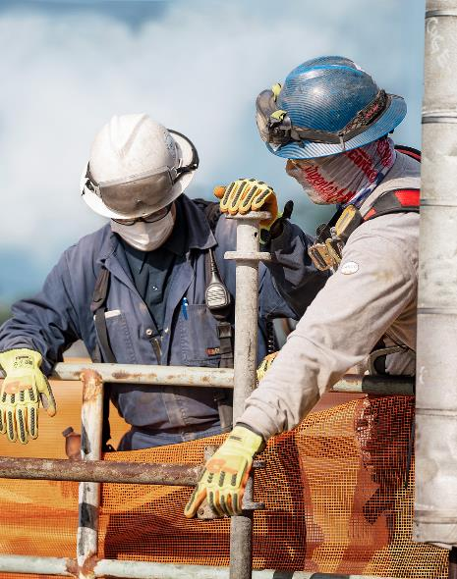
Where and when should a Start Work Check be completed?
To be effective, this should be done where the plant or equipment is located, just prior to starting the high-risk task (i.e., where the task is carried out, with the tools and equipment about to be used/worked on).
Also, the SWC’s can be used:
Anytime the jobsite is left unattended, e.g., after a work break, or for any other reason
After a shift change
If work extends beyond a single shift
If the work crew changes
If there is a change in personnel within the work crew
When requested by frontline supervisors
To reinforce stop work authority if any of the work team have concerns over the status of the controls/safeguards during the task.
Notes:
All Checks that apply to the task ahead should be used, whether a Permit to Work is required or not.
The SWCs create an opportunity for the work crew to walk through and talk through the task to be performed.

Slide 6

Who performs the work and what is their role?
Who Performs | Member(s) of the specific work crew (or a lone worker) that is about to do the task the Start Work Check is relevant for.
Worker Role | The ‘person performing work’ confirms the SWC prior to starting work. If the control/safeguard cannot be confirmed and verified (by a designated ‘verifier’) the worker should stop and ask for help before starting the task. In addition, they should: Knows the requirements of the SWC Confirms that the identified controls/safeguards are in place and functioning prior to starting the task. This requires: Having the SWC form available during confirmation Physical confirmation that each control/safeguard is in place Marking (e.g., by initialing) the form to indicate each control/safeguard on the Start-Work Check has been confirmed. Stops when a check cannot be confirmed and knows who to contact for help if a control/safeguard cannot be confirmed Informs the crew supervisor when SWC requirements are complete Waits to start work until all controls/safeguards are verified by the assigned Verifier

Slide 7

Who is the Verifier and what is their role?
Who Performs | Someone other than the worker confirming the SWC steps, who is an experienced person familiar with the activity, and performs a peer-review of the Start Work Check. If a Permit to Work (PTW) is required, the verifier should not be the permit holder. The verifier role does not replace the accountability of a permit holder or person in charge.
Verifier Role | The verifier plays an essential role in confirming all SWC controls/safeguards are in place and functioning after the person(s) performing the work have completed their confirmations. The design intent of the Start Work Checks is for the verification to function as a peer review. The verifier role should be performed by someone other than the worker confirming the SWC steps. The role of the verifier adds an additional layer of assurance for controls/safeguards that prevent fatalities and serious injuries.

Slide 8
How does the WJO and IOGP SWCs map to each other?
IOGP SWC | WJO SWC* | Mapping
Confined Space Entry | Confined Space Entry | These Start Work Checks map 1 to 1
Energy Isolation | Isolation of Hazardous Energy
De-Isolation and Re-Energization | De-Isolation of Hazardous Energy
Excavation | Excavation
Open Flame Hot Work | Hot Work
Mechanical Lifting | Lifting and Rigging
Energized/Live Electrical Systems | Energized/Live Electrical Work
Working at Height | Working at Heights
Driving |  | These IOGP Start Work Checks are additional to WJO
Work Near Water
Work Around Mobile Equipment
 | Commercial Diving | No current IOGP match

Slide 9
Thank you

